Slide 1
WHITEBOARD
Like Blackboard, but for a student project
Brian VALERA
Monico Lara Jr.
Juan Garcia
Miguel eljuri
Miguel mojica

Slide 2
TEAM MODEL
Primarily Democratic Team model with a Project manager assigning leftover tasks
Miguel Mojica – Database developer, programmer
Brian Valera – GUI development lead, documentation
Miguel Eljuri – GUI developer, programmer
Monico Lara Jr. – Testing/Documentation
Juan Garcia – Testing

Slide 3
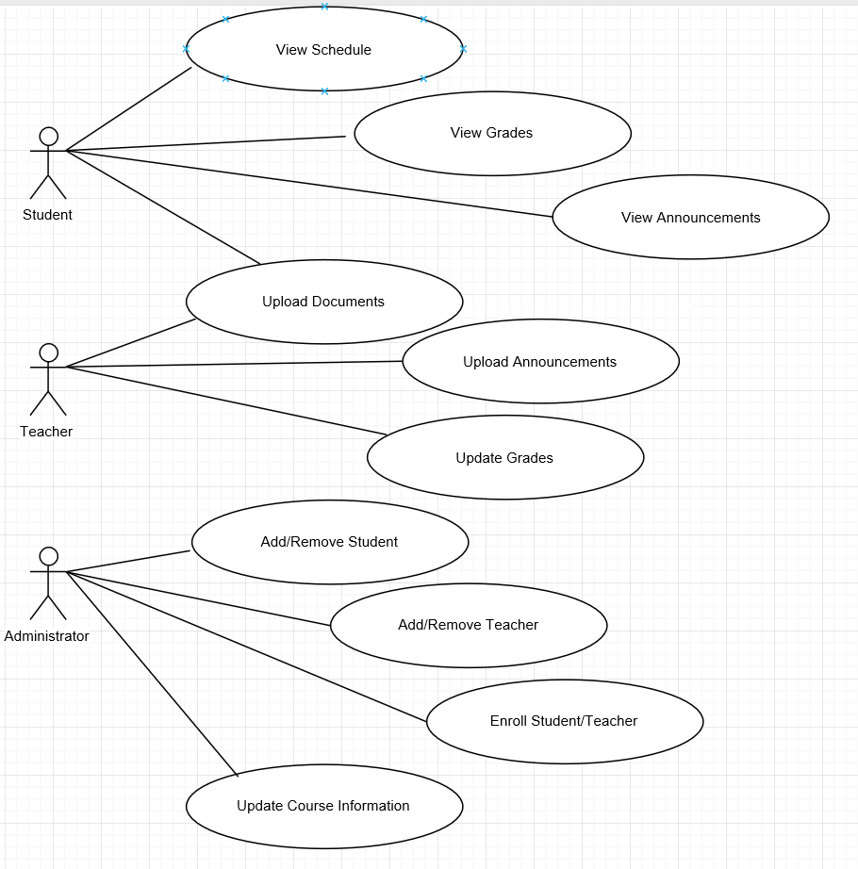
USE CASE DOCUMENT/DIAGRAM

Slide 4
CURRENT USE CASE DIAGRAM
Student
Old
Current

Slide 5
UML DIAGRAM

Slide 6
SOFTWARE PROJECT MANAGEMENT PLAN

Slide 7
CRC CARDS

Slide 8
OVERVIEW + DEMO
Basic Functionality Achieved
Additional Functionality not fully integrated
Builds are inconsistent across different computers

